Slide 1
Project 1
Generating 3D Object from DEM file Supervisors
Pascal Desbarats
Fabien Baldacci
Students
VU Manh Tu
NGUYEN Bao Xuan Truong
PHAM Phu Quoc
BUI The Anh
HO Do Quynh Phuong (left)

Slide 2
Objectives
Import DEM files from various formats
Visualize them in 3D (with rotations, translations and zooms along the axis)
Allow the user to resize or to crop them using boundary boxes
Create a support at its basis to transform it into a 3D object
Add a functionality to label it on (or below its support)
Export the result in OBJ and STL formats

Slide 3
Digital Elevation Models (DEMs)
USGS (United States Geological Survey) DEM
SDTS (Spatial Data Transfer Standard) DEM
DTED (Digital Terrain Elevation Data)
DIMAP (Defense Imagery and Mapping Program)
And more..

Slide 4
Software Architecture
Software architecture aims to:
Easy to collaborate between team members
Easy to maintain
Easy to upgrade (scalability)

Slide 5
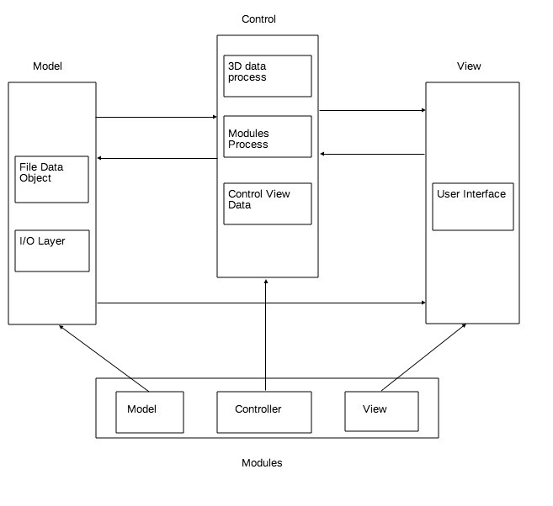
Software Architecture (cont.)

Slide 6
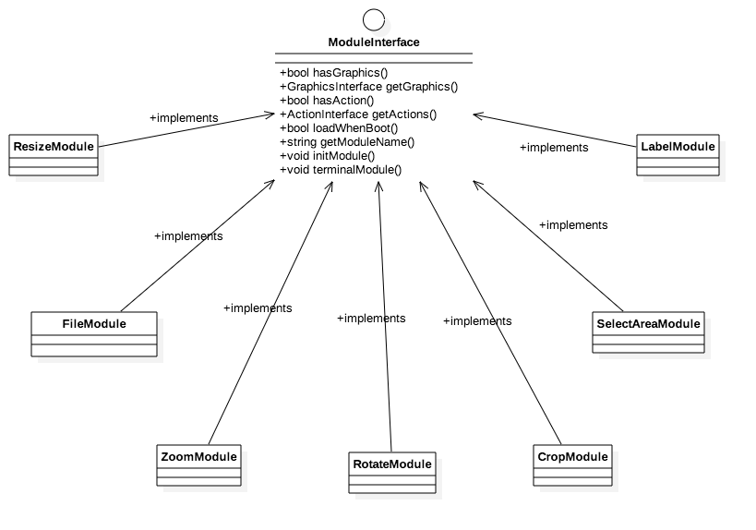
Software Architecture (cont.)

Slide 7
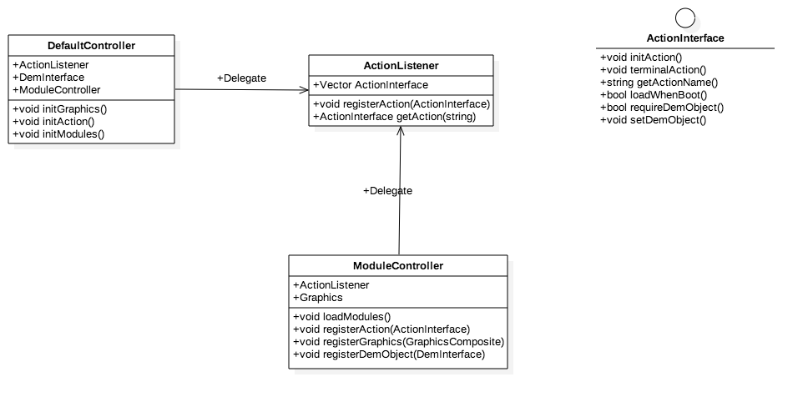
Software Architecture (cont.)

Slide 8
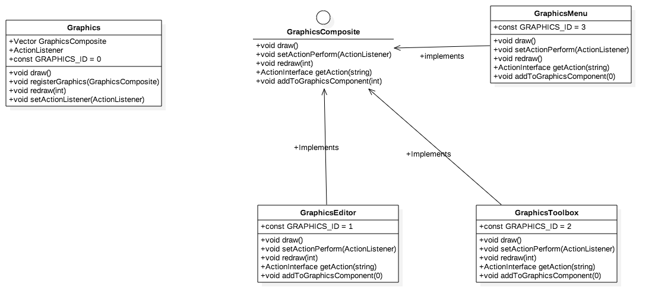
Software Architecture (cont.)

Slide 9
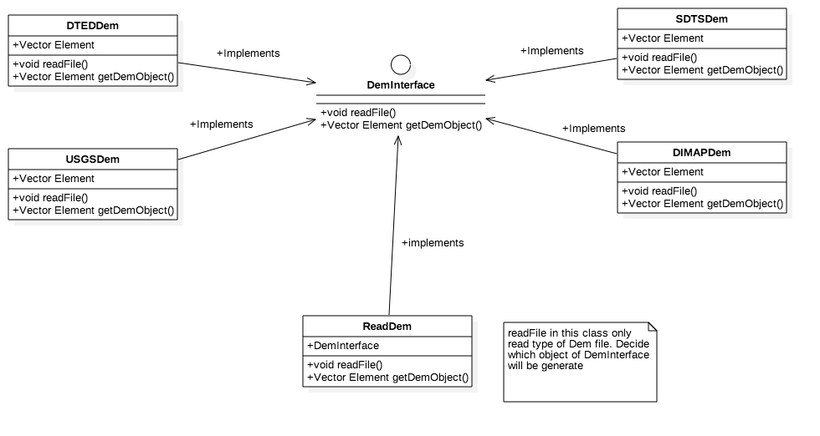
Software Architecture (cont.)

Slide 10
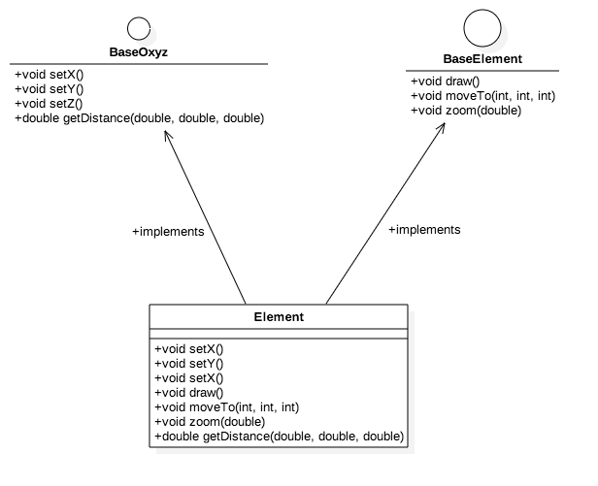
Software Architecture (cont.)

Slide 11
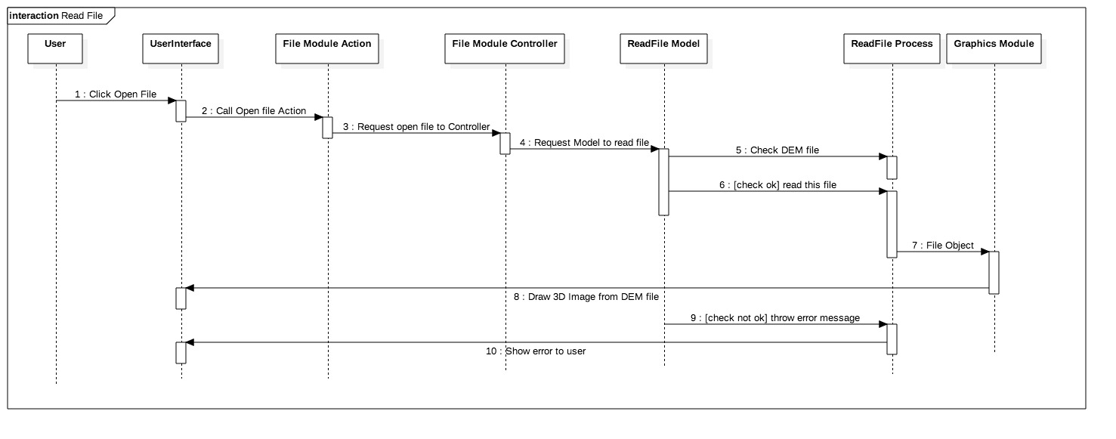
Software Architecture (cont.)

Slide 12
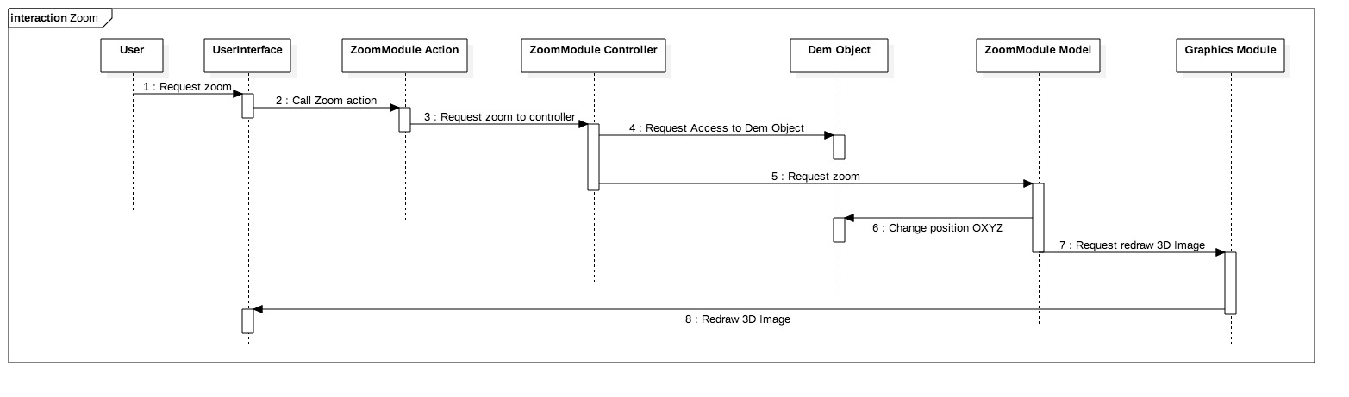
Software Architecture (cont.)

Slide 13
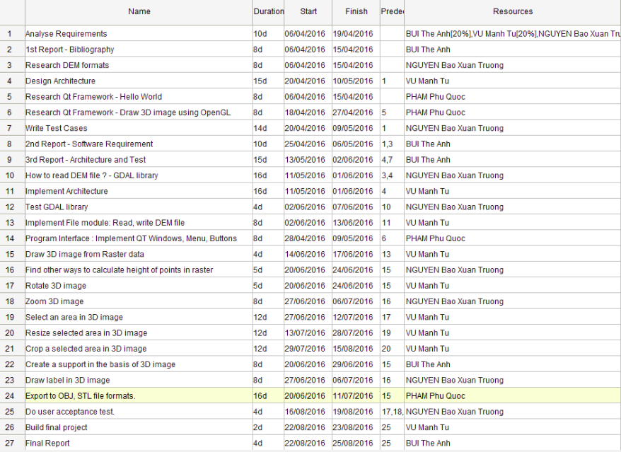
Tasks Assignment

Slide 14
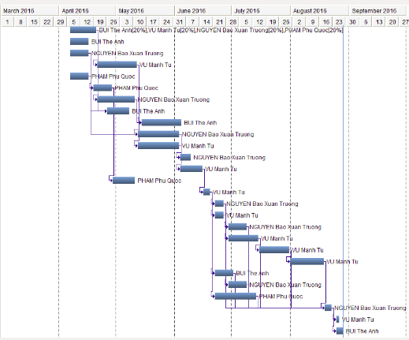
Gantt Chart

Slide 15
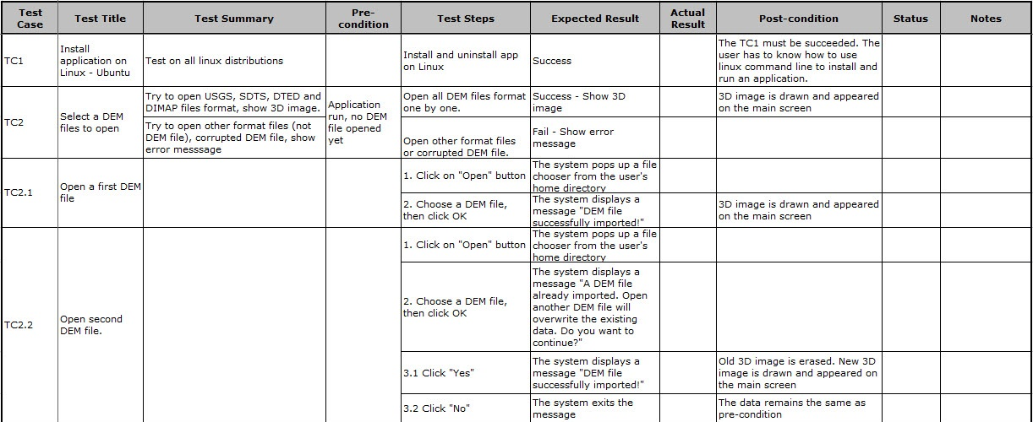
Test Cases

Slide 16
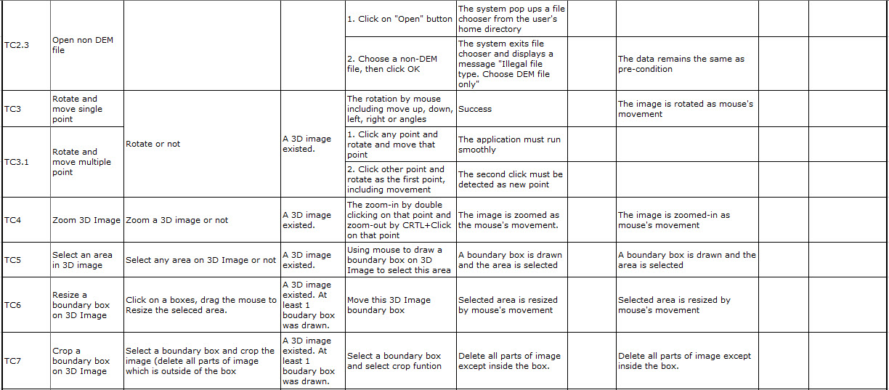
Test Cases

Slide 17
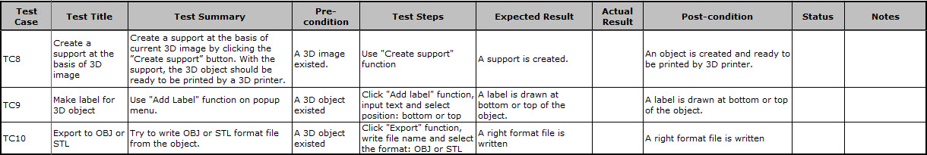
Test Cases

Slide 18
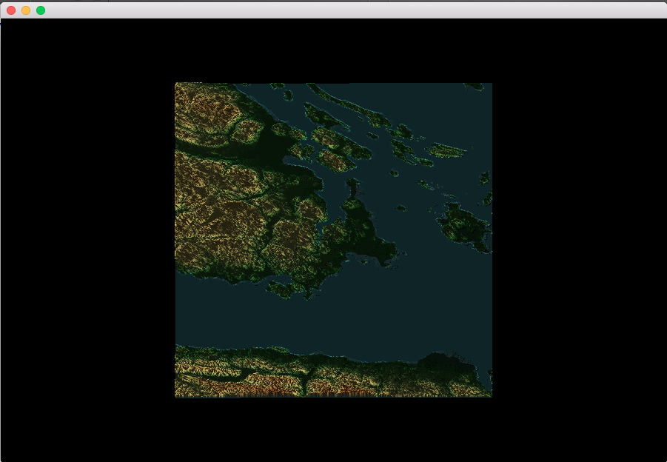
Demo (Overview)

Slide 19
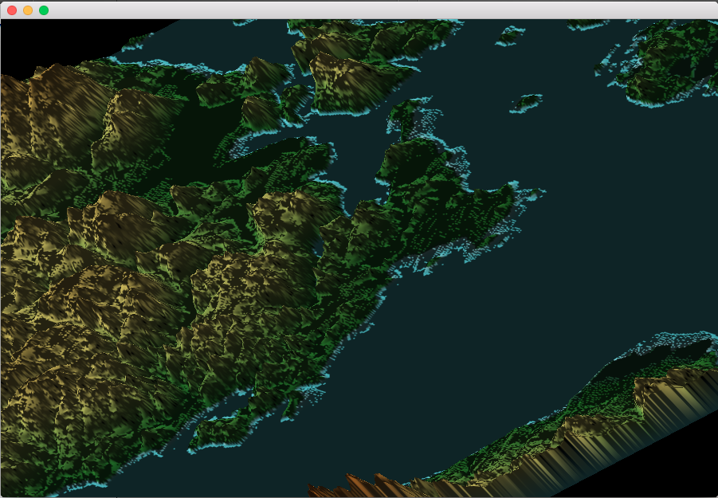
Demo (Zoom)

Slide 20
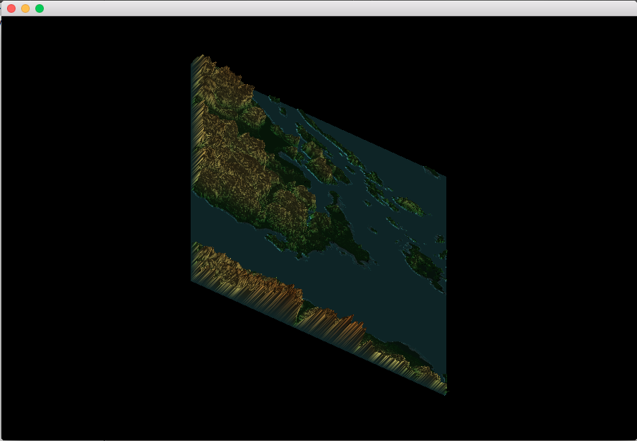
Demo (Rotate)

Slide 21
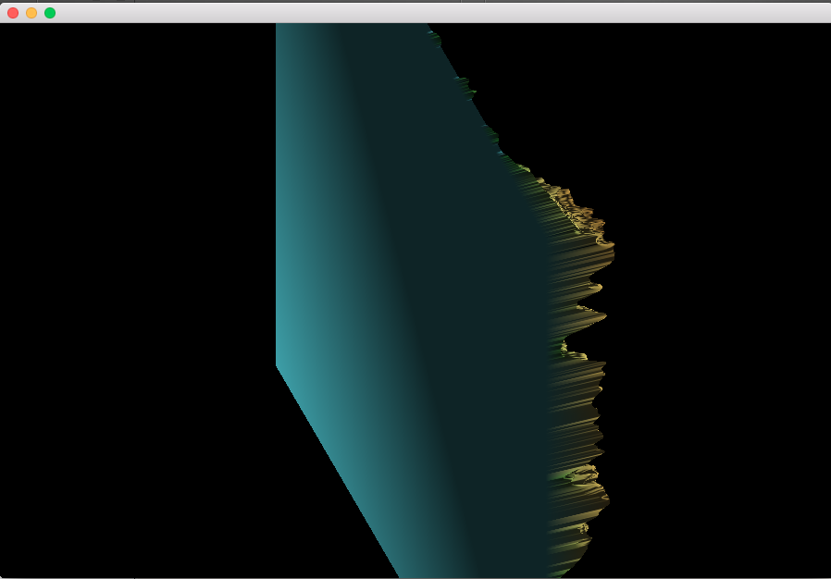
Demo (Base)

Slide 22
Drawbacks from the Project
Team members were busy, many members cannot commit to the Project.
One member left.
Difficulty in research of DEM manipulating technique.
Too new in OpenGL & Qt Framework.

Slide 23
Thank you for watching !

